Slide 1
ACMA 231
Excel: Pivot Tables

Slide 2
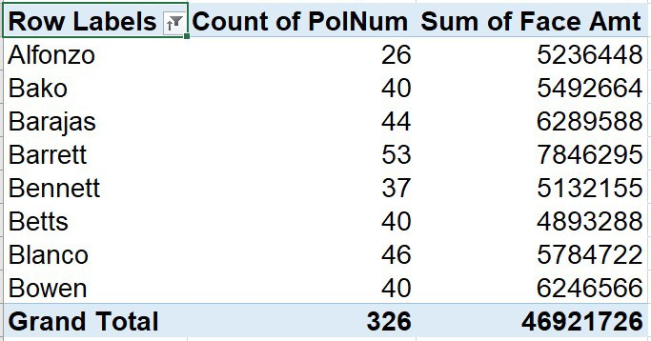
Pivot tables are a fast, flexible, and user-friendly way to summarize and analyze data in Excel. They are particularly efficient for ad-hoc analysis.
Excel: Pivot Tables
Reference data should be organized as a list or table
All columns should have headers
Can’t have any empty rows or columns

Slide 3
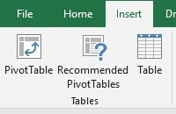
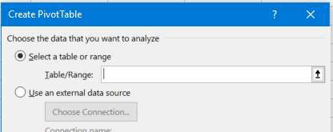

Excel: Pivot Tables
To get started, select the starting cell where you want the pivot table to be placed (i.e. where the top left corner of the pivot be placed on the sheet). Then, click the “Pivot Table” button on the “Insert” ribbon tab.
Click on the arrow button and select the data you would like your pivot table to be based off of, making sure that the column headers of the data are the first row in your selected data range. Click the arrow again and select OK.
(e.g. Sales Data 2)

Slide 4
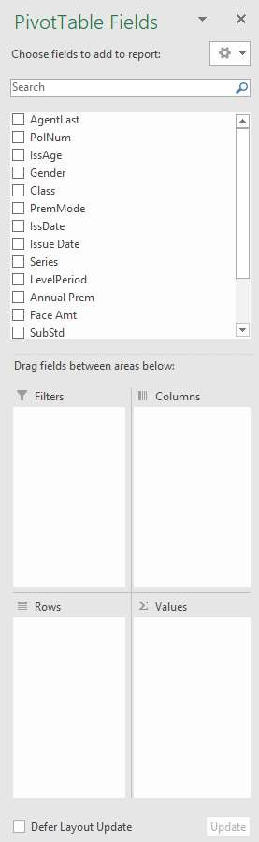
The Pivot Table Field List is where you build the structure of the pivot.
Excel: Pivot Tables
The column headers from your data source will be listed here
The desired rows for your pivot will be located here. Just drag a column header from the list and place in this box. You can have more than one category here as well, but this may complicate your pivot table. (e.g. Gender and Class)
What data do you want to aggregate by the row splits? Examples could be things like aggregated premiums or claim counts. (e.g. Face Amt)
4

Slide 5
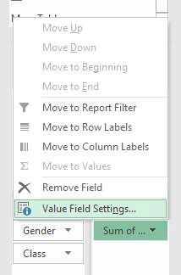
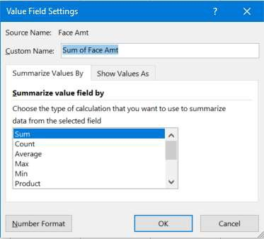
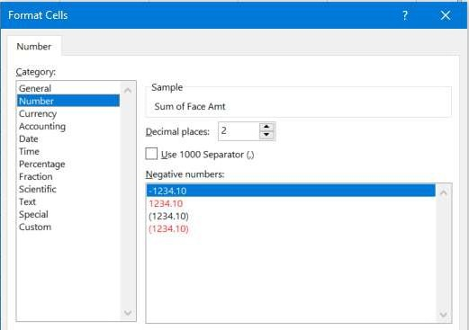
Excel: Pivot Tables
We can choose many different aggregation methods for the data in the body of our Pivot Table, by the different column content.
Either right-click on the Pivot Table column or click on the field in the Field List, and select “Value Field Settings”.
You can see that we have MANY choices here.
If you click on “Number Format”, you can also select the way the data is displayed in the Pivot Table.
5

Slide 6
The Pivot Table Field List is where you build the structure of the pivot.
Excel: Pivot Tables
The column headers from your data source will be listed here
The desired rows for your pivot will be located here. Just drag a column header from the list and place in this box. You can have more than one category here as well, but this may complicate your pivot table. (e.g. Gender and Class)
What data do you want to aggregate by the row splits? Examples could be things like aggregated premiums or claim counts. (e.g. Face Amt)
You may want to split the data into even finer groupings. You can add additional columns by dragging column headers from the list and placing them in this box. You can have more than one here, but this may complicate your pivot table. (e.g. PremMode)
You can also add one or many filters by dragging column headers here. (e.g. drag Gender from the Row box to the Filter box)
6

Slide 7
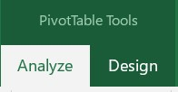
When clicking anywhere in your Pivot Table, not only do we see the Field List, but the ribbon adds a new tab for Pivot Table Tools.
Excel: Pivot Tables
The Analyze tab contains many capabilities. All the way to the left, you can name your Pivot Table. You can also access the Pivot Table options, which has MANY different choices of settings for your table. The Analyze tab also has the ability to make Pivot Charts, which are built directly off of your Pivot Table and will refresh when you refresh your table. Within “Fields, Items, & Sets”, you can create calculated fields, which are often helpful. Also, you can make the Field List disappear and reappear by clicking on the button, located on the right in the Analyze tab.
7

Slide 8
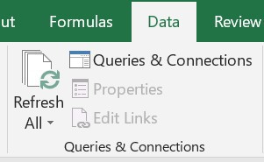
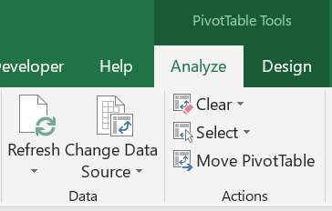
Excel: Pivot Tables
When you set the data source for your Pivot Table, a copy of that data source is being created in the metadata (i.e. “behind the scenes”). The Pivot Table is actually pulling from this Pivot Table Cache. This allows for you to make changes in the data without it directly affecting your Pivot Tables until you desire. As such, if you make changes to your data and you want those changes reflected in the Pivot Table, you will need to click on the Refresh button, which updates the Pivot Table Cache with the new update.
or

Slide 9
You may also want to change the data used for your Pivot Table (e.g. maybe you like the structure of the Pivot and have another data source with the same column headers, but newer data).
Excel: Pivot Tables
(e.g. Change the data to Sales Data 1)

Slide 10
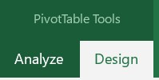
When clicking anywhere in your Pivot Table, not only do we see the Field List, but the ribbon adds a new tab for Pivot Table Tools.
Excel: Pivot Tables
On the Design tab, you can change the color and format of your Pivot Table. You can also decide whether or not to have row and/or column headers, and how/whether to display subtotals and/or grand totals.
(e.g. Change our Pivot Table to another color without Grand Totals)

Slide 11
Excel: Pivot Tables
If you would like to view the specific underlying data for a particular value seen in your Pivot Table, simply double- click on the value and a new worksheet will be created with the rows associated with this value. For example, maybe you noticed in your Pivot Table that for Males in the state of California, the premiums look a little strange for Territory 5. You can double-click on this value in the Pivot Table and it will supply all the rows of data for California Males in Territory 5 from your data source. Super helpful for deep dive analysis!
(e.g. Try it out on our table by double-clicking on any chosen value)

